Slide 1
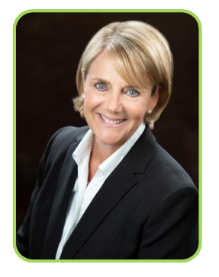

Renee Broadbent, MBA, CCSFP
SoNE HEALTH Chief Information Officer & Information Security Officer | Chief Compliance & Privacy Officer President, HIMSS New England
Renee Broadbent joined SoNE HEALTH as Vice President of Information Technology in January of 2021 was named Chief Information Officer in 2022. She is a senior level healthcare executive with extensive background in strategic planning, information technology, digital strategy, value-based care and data security. She has held the role of Chief Information Officer and Chief Information Security Officer in both hospital health systems and Managed Care Organizations (MCO). She currently serves as SoNE’s Chief Information Officer and Information Security Officer as well as its Chief Compliance & Privacy Officer.
Prior to joining SoNE, Renee served as Senior Manager at Wolf & Company, P.C. and as AVP of Population Health Information Technology and Strategy at UMass Memorial Health Care in Worcester, Massachusetts. While at UMass Memorial, she led the data and analytics team to help UMass Memorial Health Care achieve HIMSS Stage 7 Analytics for both inpatient and outpatient, only 2% of health systems in the country achieve this honor.
Since coming to SoNE, she has implemented a robust Medical Economics System, a state-of-the-art Security Strategy and implementation, ensuring the highest level of data security for SoNE. Further, she’s built a robust data warehouse and was one of the first organizations to connect to the Connecticut state HIE, Connie.
Renee serves on several advisory boards related to technology, is an Adjunct Professor at Southern New Hampshire University, is HITRUST Certified, and is an accomplished author. She speaks frequently at HIMSS events on a variety of topics including Digital Strategy, Health Equity and Data Security and is currently the President of HIMSS New England and a founding member of Bluebird Leaders.
Cell: (413) 478-4557 Renee.Broadbent@sonehealthcare.com

